Slide 1
PENGANTAR METODE CRISP-DM (CRoss-Industry Standard Process for Data Mining)
Joko Suntoro
joko@jokosuntoro.com
SMS/Telp: 0822-4236-9670
WA/Telegram: 085-641-970-170
http://jokosuntoro.com

Slide 2

Joko Suntoro
SDN Pandean Lamper 03 Semarang (2001)
SMPN 32 Semarang (2004)
SMA Institut Indonesia Semarang (2007)
S1 Teknik Informatika Universitas Semarang (2010-2015)
S2 Teknik Informatika Universitas Dian Nuswantoro (2015-2016)
Tim Operasi dan Teknik, Domestic Gas PT Pertamina (Persero) (2008-sekarang)
Dosen dan Peneliti di Fakultas Teknologi Informasi dan Komunikasi Universitas Semarang
Peneliti dan Reviewer di Romi Satria Wahono (RSW) Intelligent System Research Group
Bidang Penelitian: Data Mining, Intelligent System dan Machine Learning

Slide 3
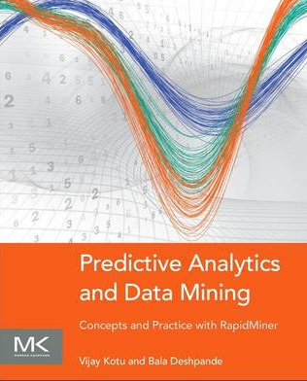
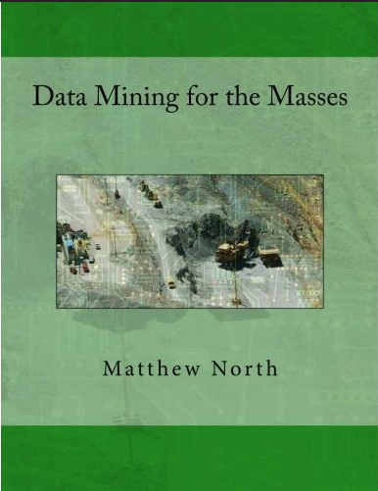
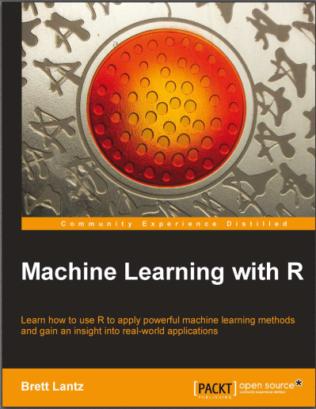
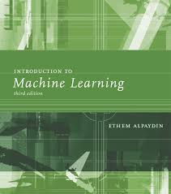
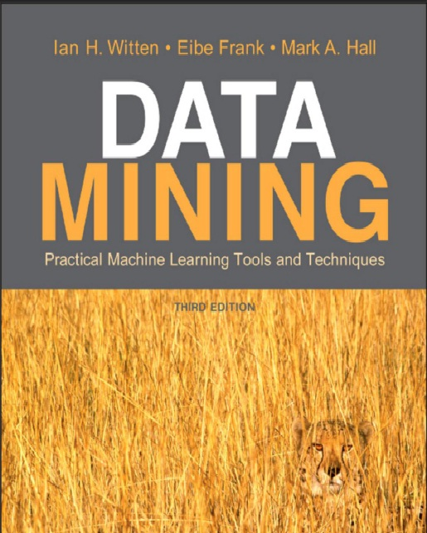
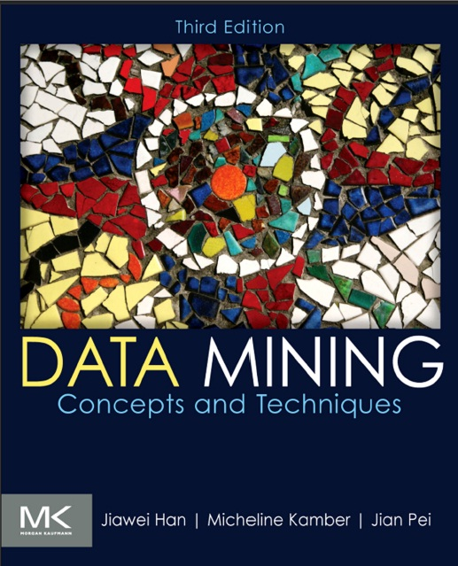
Textbooks

Slide 4
1. Pengenalan Metode CRISP-DM

Slide 5
The Data Mining Standard Process
The Cross-Industry Standard Process for Data Mining (CRISP–DM) was developed in 1996 (Chapman, 2000)
A cross-industry standard was clearly required that is industry neutral, tool-neutral, and application-neutral
CRISP-DM provides a nonproprietary and freely available standard process for fitting data mining into the general problem-solving strategy of a business or research unit

Slide 6
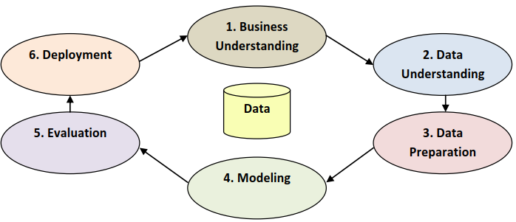
CRISP-DM Conceptual Model
(North, 2012)

Slide 7
1.1 Business Understanding
Business Understanding disebut juga dengan Organization Understanding
Business Understanding adalah langkah awal dan sangat penting agar hasil data mining berhasil.
Memberitahukan tujuan dan persyaratan project secara jelas dalam hal bisnis atau unit penelitian secara keseluruhan.
Merancang apa yang akan Anda bangun

Slide 8
1.2 Data Understanding
Proses persiapan dan pengumpulan data
Evaluasi kualitas data
Pilih subset data yang menarik, yang mungkin mengandung pola yang dapat ditindaklanjuti

Slide 9
1.3 Data Preparation
Pilih kasus dan variabel yang akan dianalisis
Lakukan data cleaning, data integration, data reduction dan data transformation
Data preparation dapat membantu meningkatkan peluang keberhasilan

Slide 10
1.4 Modeling
A model, in data mining at least, is a computerized representation of real-world observations.
Models are the application of algorithms to seek out, identify, and display any patterns or messages in your data
Models are where data mining moves from preparation and understanding to development and interpretation

Slide 11
1.5 Evaluation
Evaluate the one or more models delivered in the modeling phase for quality and effectiveness before deploying them for use in the field
Determine whether the model in fact achieves the objectives set for it in the first phase
Establish whether some important facet of the business or research problem has not been accounted for sufficiently
Come to a decision regarding use of the data mining results

Slide 12
1.6 Deployment
Make use of the models created:
model creation does not signify the completion of a project
Example of a simple deployment:
Generate a report
Example of a more complex deployment:
Implement a parallel data mining process in another department
For businesses, the customer often carries out the deployment based on your model

Slide 13
2. Differences Between Database, Data Warehouse and Datasets

Slide 14
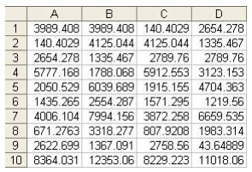
Organisasi Data
Data terdiri dari baris dan kolom
Di database, baris disebut dengan tuples atau records, sedangkan kolom disebut dengan fields
Di data warehouse dan dataset, baris disebut dengan observations, examples atau cases, sedangkan kolom disebut dengan attributes atau columns.

Slide 15
2.1 Database
A database is an organized grouping of information within a specific structure.
By relating tables to one another, we can reduce redundancy of data and improve database performance, we called normalization
Most relational databases which are designed to handle a high number of reads and writes (updates and retrievals of information) are referred to as OLTP (online transaction processing) systems

Slide 16
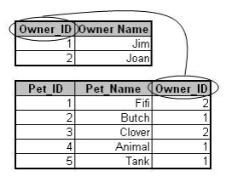
2.1 Database

Slide 17
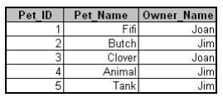
2.2 Data Warehouse
A data warehouse is a type of large database that has been denormalized and archived
Denormalization is the process of intentionally combining some tables into a single table
We reduce the number of joins necessary to query related data, thereby speeding up the process of analyzing our data
Databases designed in this manner are called OLAP (online analytical processing) systems.

Slide 18
2.3 Datasets
A data set is a subset of a database or a data warehouse
It is usually denormalized so that only one table is used
Data sets may be made up of a representative sample of a larger set of data, or they may contain all observations relevant to a specific group

Slide 19
Referensi
Bache, K., & Lichman, M. (2013). UCI Machine Learning Repository. Retrieved from http://www.ics.uci.edu/~mlearn/MLRepository.html
Ethem Alpaydin. Introduction to Machine Learning. 3rd ed. MIT Press. 2014
Harrington, P. (2012). Machine Learning in Action. United States of America: Manning Publications Co.
Hofmann, M., & Klinkenberg, R. (2013). Rapid Miner Data Mining Use Cases and Business Analytics Applications. CRC Press Taylor & Francis Group
Ian H. Witten, Frank Eibe, Mark A. Hall. Data mining: Practical Machine Learning Tools and Techniques 3rd Edition. Elsevier. 2011
Jiawei Han and Micheline Kamber. Data Mining: Concepts and Techniques Third Edition. Elsevier. 2012
Lantz, Brett. Machine Learning with R. Packt Publishing. 2013
Larose, D. T. (2006). Data Mining Methods and Models. Data Mining Methods and Models. Canada: Willey Publishing, Inc.
Noth, Matthew. Data Mining for The Masses. Creative Commons Attribution. 2012
V. Kotu, Predictive analytics and data mining. USA: Elsevier Inc., 2015.
Wahono, R. S. (2016). Computing Courses Data Mining. Retrieved from http://romisatriawahono.net/dm/

